Slide 1
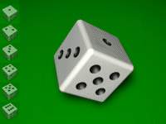

統計學一上 Chapter 7: Random Variables and Discrete Probability Distributions
Nov. 1, 2017
By
Ching-Chin Chern

Slide 2

Agenda
Random Variables and Probability Distributions
Bivariate Distributions
Known Theoretical Discrete Probability Distributions

Slide 3
Known Theoretical Discrete Probability Distributions
The Binomial Distribution
The Poisson Distribution
Geometric Probability Distribution
Hypergeometric Probability Distribution

Slide 4
Geometric Random Variables
Number of failures, X, in the Geometric Experiment or number of failures before the first success.

Slide 5
Geometric Distribution
P(X = x) = p(1 – p)^{x}
where p = the probability of success and x = the number of failures before success

Slide 6
Shapes of G(X) given p

Slide 7
Expected Value and Variance of Geometric Distribution
X ~ G(p) where p is the input parameter

Slide 8
Note
If p > 0.5, then E(X) < 1. Otherwise, if p ≤ 0.5, then E(X) ≥ 1.
Geometric Distribution has memoryless property. Whenever a success occur, all the conditions are reset. The counting starts again.

Slide 9
Example
Suppose that the rule of a game is to stop whenever the player wins. The probability of winning for the player in each game is 0.25.

Slide 10
Question 1
What is the probability of playing totally 5 games?
Define X as the number of games before the player wins and p = 0.25.
P(X = 4) = p(1 – p)⁴
= (0.25)(1-0.25)⁴ = 0.0791

Slide 11
Question 2
What is probability that the player needs to play 3 games before the last winning game?
P(X = 3)
= p(1 – p)³
= (0.25)(1 – 0.25)³ = 0.1055

Slide 12
Question 3
What is the expected number of games before stop?

Slide 13
Question 4
What is the expected number of total plays?

Slide 14
Question 5
What is the variance and standard deviation of number of plays before stop?

Slide 15
Question 6
Compute and explain 3σ region by Chevyshev’s Theorem: k = 3.
88.89% of the people need to play 0 to 13 games in order to stop (obtain a success). In fact, P(X≤13)=0.9822.

Slide 16
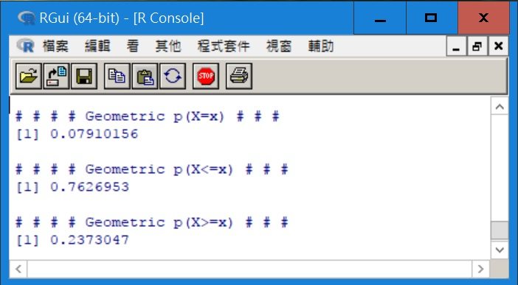
R Code
p <- 0.25
x <- 4
cat("# # # # Geometric p(X=x) # # # ","\n")
print(dgeom(x, p))
cat(" ","\n")
cat("# # # # Geometric p(X<=x) # # # ","\n")
print(pgeom(x, p, lower.tail = TRUE))
cat(" ","\n")
cat("# # # # Geometric p(X>=x) # # # ","\n")
print(pgeom(x, p, lower.tail = FALSE))

Slide 17
Known Theoretical Discrete Probability Distributions
The Binomial Distribution
The Poisson Distribution
Geometric Probability Distribution
Hypergeometric Probability Distribution

Slide 18
Hypergeometric Experiment
If n items are selected from population with totally N items (Finite Population), within which, r items are “successful”, count the number of “successful” items, X.

Slide 19
Hypergeometric Random Variable
There are totally N items in a population within which, r items are successful
Let X be the number of successes in n Bernoulli trials.
X is a Hypergeometric random variable.

Slide 20
Hypergeometric Probability Distribution
Let X be the number of successes in n Bernoulli trials with population size = N and total number of success items = r.

Slide 21
Expected Value and Variance
X~HG(N, r, n) where N, r, and n are input parameters.

Slide 22
Example
25 Auto parts are shipped to a dealer. Five of those auto parts were defective. Three of them were sold before the company contacted the dealer.

Slide 23
Question 1
What is the probability that all three are defective?
Define X as the number of defective items with N = 25, r = 5 and n = 3

Slide 24
Question 2
What is the probability that at least one of them are defective?
=.413 + .087 + .0043 =.5043

Slide 25
Example
Of 12 managers, 7 are female and 5 are male. The company is planning to send 3 to a conference.

Slide 26
Question 1
What is the probability that All three of them are female?
Define X as the number of females with N = 12, r = 7 and n = 3

Slide 27
Question 2
What is the probability that at most one of them is female?
= .0454 + .3182 = .3636

Slide 28
Shapes of HG(N, r, n)

Slide 29
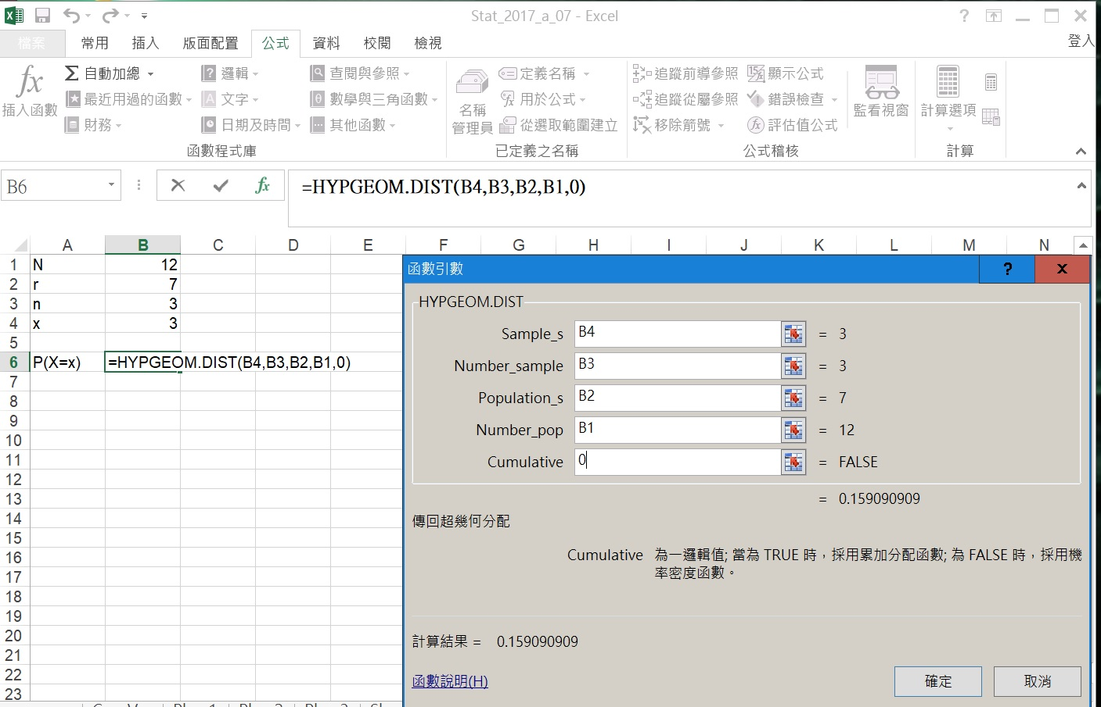
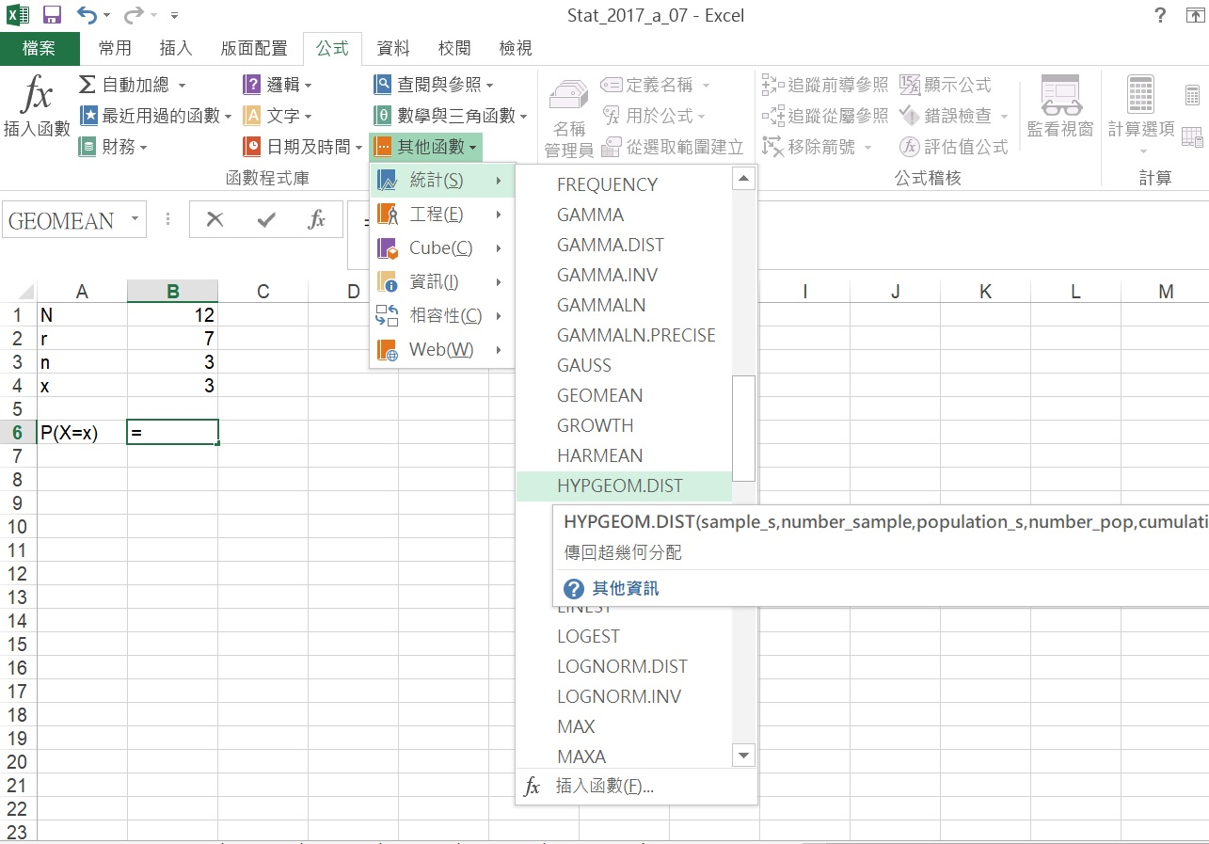
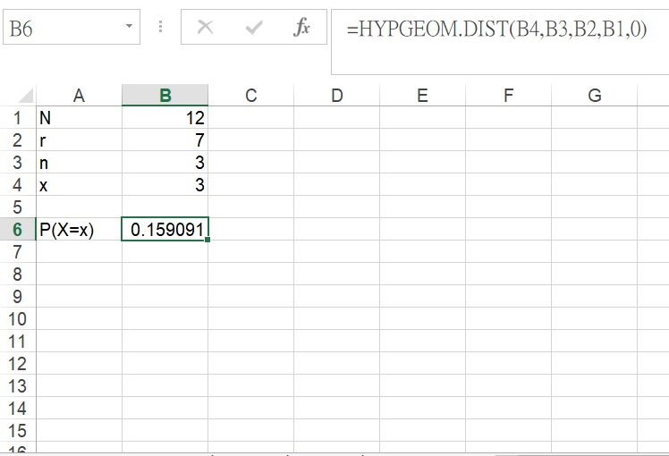
Excel Setup

Slide 30
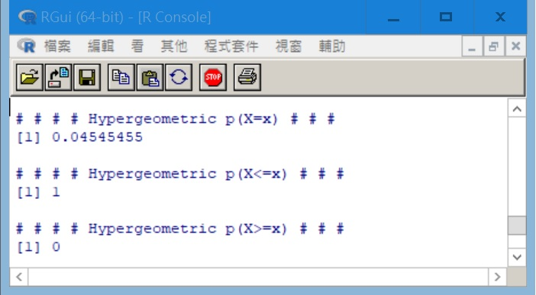
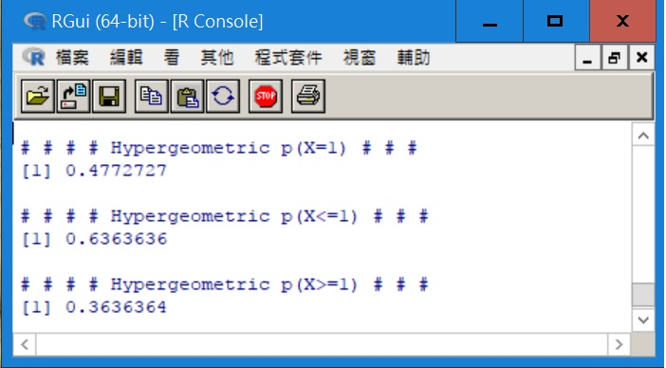
R Code
= N – r
N <- 12
r <- 7
n <- 3
x <- 3
m <- 5
cat("# # # # Hypergeometric p(X=x) # # # ","\n")
print(dhyper(x, m, r, n))
cat(" ","\n")
cat("# # # # Hypergeometric p(X<=x) # # # ","\n")
print(phyper(x, m, r, n, lower.tail = TRUE))
cat(" ","\n")
cat("# # # # Hypergeometric p(X>=x) # # # ","\n")
print(phyper(x, m, r, n, lower.tail = FALSE))

Slide 31
End of Chapter 7 Part B

Slide 32
Chapter 8: Continuous Probability Distributions

Slide 33
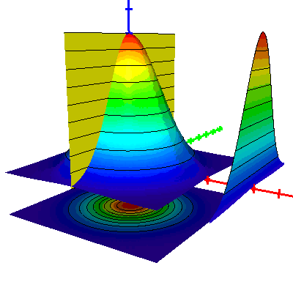
Agenda
Probability Density Functions
Normal Distribution
Exponential Distribution

Slide 34
Continuous Random Variable
A random variable that can assume any value contained in one or more intervals. Because the number of values contained in any interval is infinite, the possible number of values that a continuous random variable can assume is also infinite and not countable.

Slide 35
Examples of Continuous Random Variable
Life of a battery
Salaries of workers
Prices of houses
Learning time of a worker

Slide 36
Point Probabilities are Zero
The probability that a continuous variable X will assume any particular value is zero.
P(X = x) = 0 ⇒ Why?

Slide 37
Why P(X = x) = 0 ?
When the number of values approaches infinity (because X is continuous) the probability of each value approaches 0.
As the number of values increases, the probability of each value decreases because the sum of all the probabilities remains 1.
The probability of each value
1/4 + 1/4 + 1/4 + 1/4 = 1
1/3 + 1/3 + 1/3 = 1
1/2 + 1/2 = 1
0
1/3
1/2
2/3
1

Slide 38
Point Probabilities are Zero
Because there is an infinite number of values, the probability of each individual value is virtually 0.
Thus, we can determine the probability of a range of values only. It is meaningful to talk about P(X ≤ 5) but not P(X = 5).

Slide 39
Discrete vs. Continuous
With a discrete random variable, like tossing a die, it is meaningful to talk about P(X = 5).
In a continuous setting (e.g. with time as a random variable), the probability the random variable of interest, say task length, takes exactly 5 minutes is infinitesimally small, hence P(X = 5) = 0.

Slide 40
Probability Density Function 1/2
A function f(x) is called a probability density function (over the range a ≤ x ≤ b)
f(x)
area=1
a
b
x

Slide 41
Probability Density Function 2/2
The density function, f(x), satisfies the following conditions
f(x)≥0 for all x between a and b,
The total area under the curve representing f(x) equals 1.
Area = 1
a
b

Slide 42
Probability Function
The probability that x falls between c and d is found by calculating the area under the graph of f(x) between c and d.
P(c<x<d)
or
P(c≤x≤d)
a
c
d
b

Slide 43
Note
(1) f(x) ≠ P(X = x).
(2) P(X = x) = 0 for all x (point probability = 0).
(3) F(x) = P(X ≤ x) = ∫_{a}^{x} f(s)ds is known as cumulative probability distribution.

Slide 44
Example
Define X as the elapsed time (in minutes) from placing an order at the drive-through speaker to picking up the order.

Slide 45
Plot of F(x)
0.981
0.993
1.000
0.961
0.928
0.874
0.786
0.639
0.398

Slide 46
Question 1
Find the probability that service time is no more than 3 minutes.
= 0.928

Slide 47
Question 2
Find the probability that service time is equal to 2 minutes.
= 0

Slide 48
Question 3
Find the probability that service time is more than 1 minutes.
= 1 – 0.398
= 0.602

Slide 49
Question 4
Find the probability that service time is in between 1.5 minutes and 4 minutes.
= 0.981 – 0.639
= 0.342

Slide 50
Mean and Variance
Mean:
Variance:
Note : Without knowing f(x), there is no way to compute μ and σ².

Slide 51
Uniform Density Distribution
A random variable X is said to be uniformly distributed if its density function is
f(x)
x
a
b

Slide 52
Uniform Probability Distribution
A random variable X is said to be uniformly distributed as
The probability distribution is
Where a ≤ y ≤ b.

Slide 53
Uniform Probability Distribution
f(x)
Symmetric
1
x
a
c
d
b
where a ≤ c ≤ x ≤ d ≤ b.

Slide 54
Expected Value and Variance of Uniform Probability Distribution
Mean:
Variance:

Slide 55
Example
The time elapses between the placement of an order and the delivery time is uniformly distributed between 100 and 180 minutes.
f(x) = 1/80 100 ≤ x ≤ 180
1/80
x
100
180

Slide 56
Question 1
What proportion of orders takes between 2 and 2.5 hours to deliver?
f(x) = 1/80 100 ≤ x ≤ 180
P(120 ≤ x ≤ 150)
= (150-120)(1/80)
= .375
1/80
x
100
120
150
180

Slide 57
Question 2
The expected value and variance of the time elapses between the placement of an order and the delivery time ?
f(x) = 1/80 100 ≤ x ≤ 180
1/80
x
100
180

Slide 58
Agenda
Probability Density Functions
Normal Distribution
Exponential Distribution

Slide 59
The Normal Distribution
This is the most important continuous distribution considered here.
Many random variables can be properly modeled as normally distributed.
Many distributions can be approximated by a normal distribution.
The normal distribution is the cornerstone distribution of statistical inference.

Slide 60
The Normal Distribution
A random variable, X, with mean μ and variance σ² is normally distributed if its probability density function is given by

Slide 61
Shape of Normal Distribution
A bell shaped distribution, symmetrical around μ
μ

Slide 62
(μ, σ) vs. Shapes
How does the expected value affect the location of f(x)?
μ = 11
μ = 10
μ = 12
How does the standard deviation affect the shape of f(x)?
σ = 2
σ = 3
σ = 4

Slide 63
Finding Normal Probabilities
The normal distribution is unimodal and symmetrical.
Any normal distribution can be transformed into a specific normal distribution called “Standard Normal Distribution”

Slide 64
Standard Normal Distribution
X ~ N(μ, σ) = Z ~ N(0, 1)
0

Slide 65
Standard Normal Variable
Every normal variable X with μ and σ, can be transformed into Z.
where E(Z)=μ_{z}=0 and Var(Z)=1 or σ_{z}=1
Therefore, once probabilities for Z are calculated, probabilities of any normal variable can found.

Slide 66
Table 3 (pages B-8 to B-9)
If we know μ and σ of a normally distributed random variable, we can always transform the probability statement about X into a probability statement about Z.
This table lists cumulative probabilities P(Z < z) for values of z ranging from −3.09 to +3.09

Slide 67
Example
Suppose that at another gas station the daily demand for regular gasoline is normally distributed with a mean of 1,000 gallons and a standard deviation of 100 gallons.

Slide 68
Inventory and Supply
The station manager has just opened the station for business and notes that there is exactly 1,100 gallons of regular gasoline in storage. The next delivery is scheduled later today at the close of business.

Slide 69
Question?
The manager would like to know the probability that he will have enough regular gasoline to satisfy today’s demands.

Slide 70
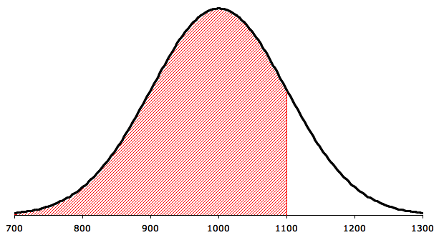
Solution 1/4
The demand, X, is normally distributed with mean μ = 1,000 and standard deviation σ = 100. We want to find the probability, P(X ≤ 1,100)

Slide 71
Solution 2/4
The first step is to standardize X. However, if we perform any operations on X we must perform the same operations on 1,100. Thus,

Slide 72
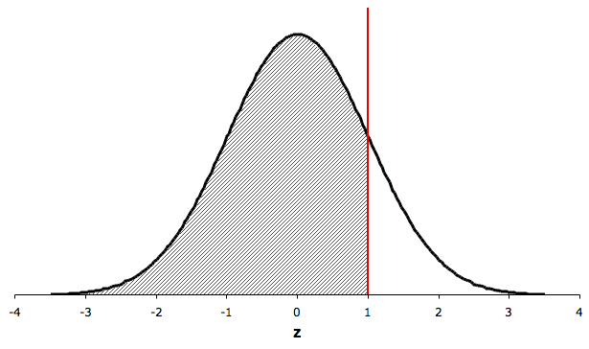
Solution 3/4
Normal density function for X
Normal density function for Z

Slide 73
Solution 4/4
Using Table 3, The probability that we seek is P(X ≤ 1,100) = P( Z ≤ 1.00)
= .8413

Slide 74
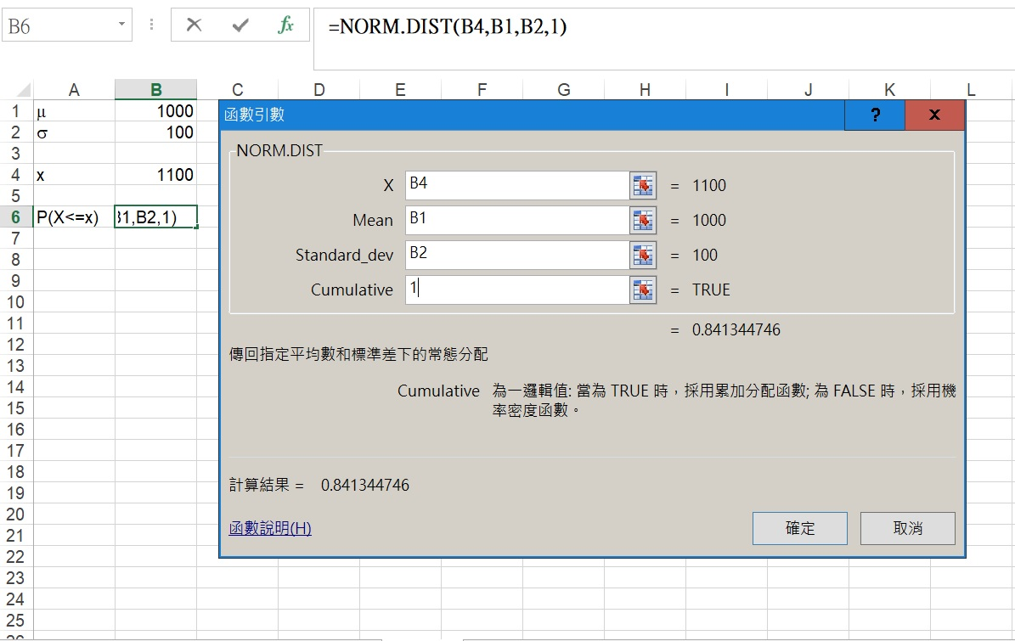
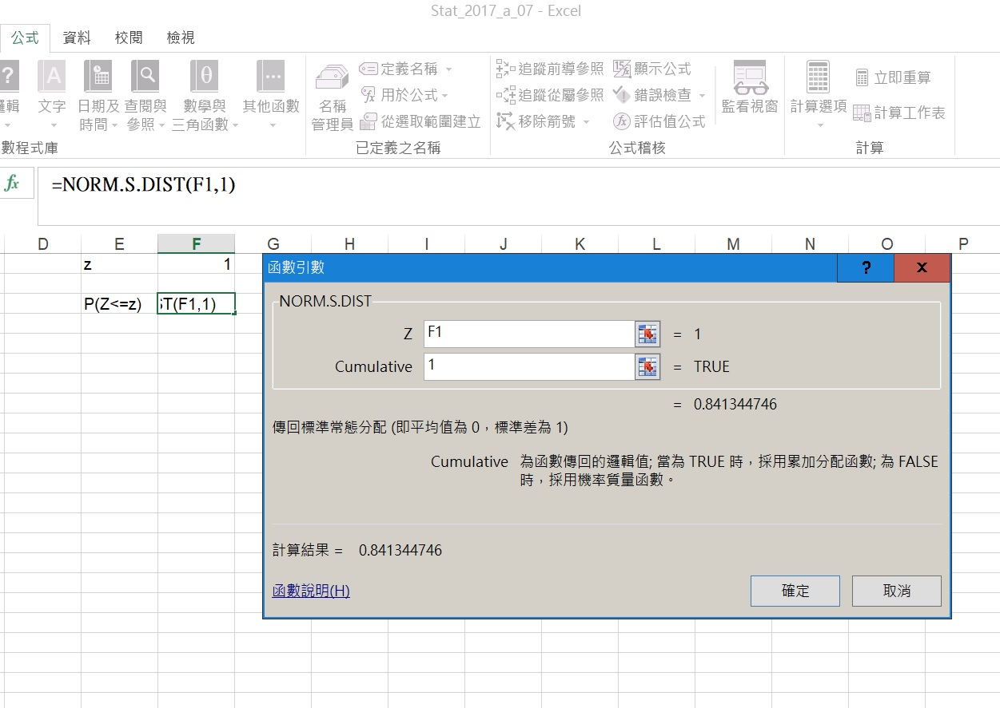
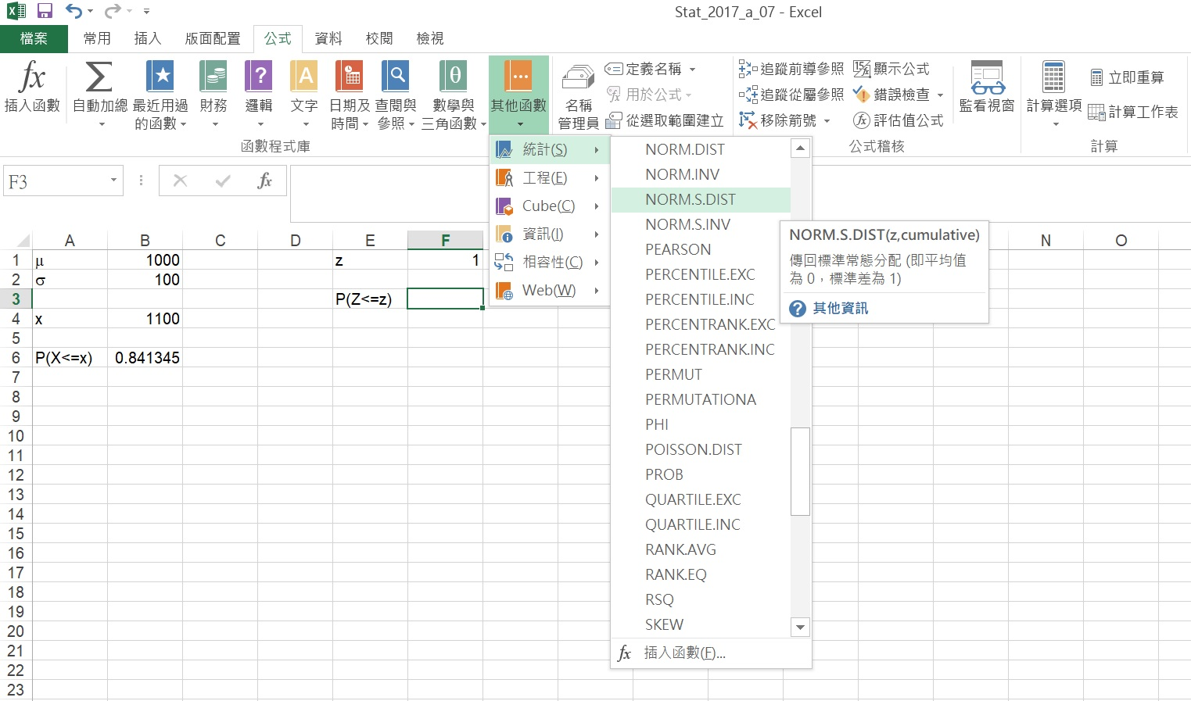
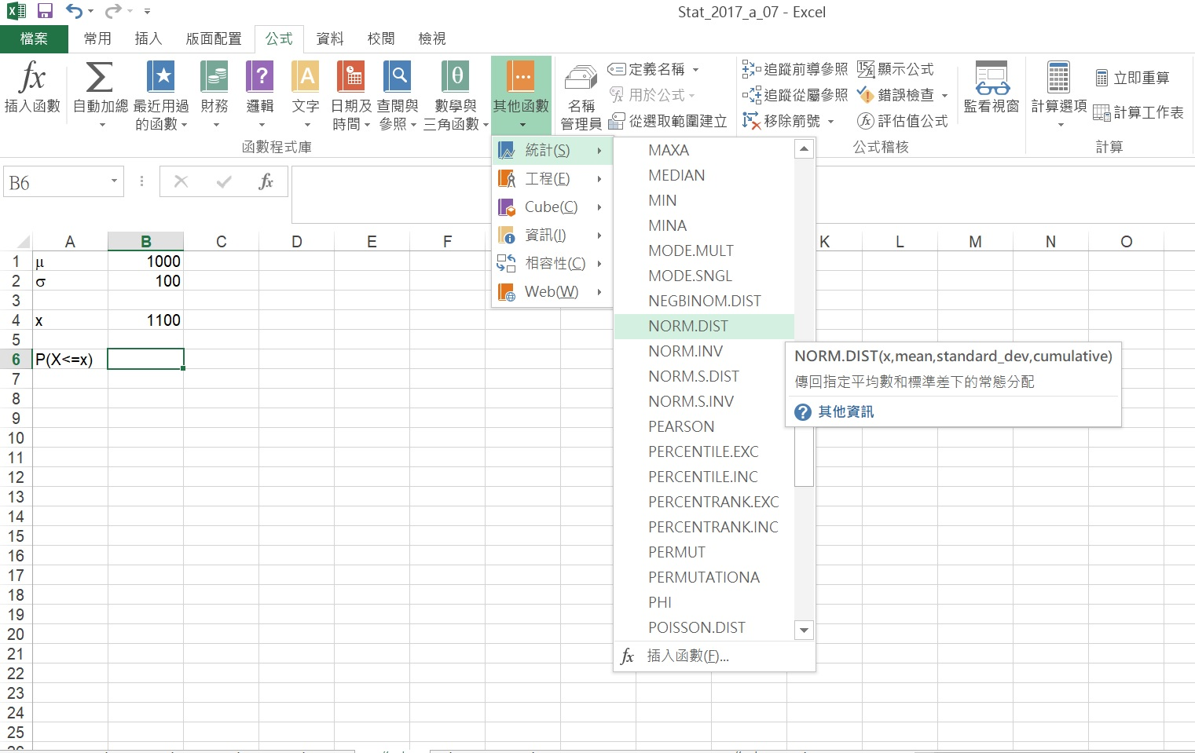
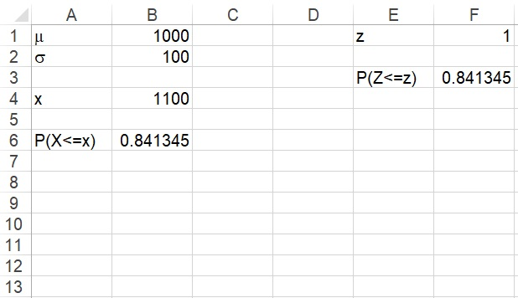
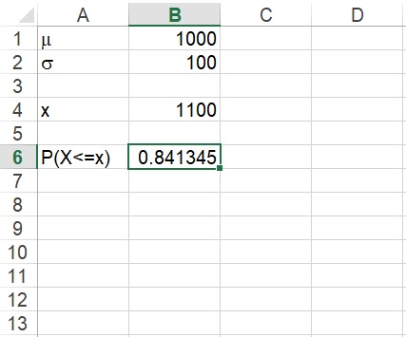
Excel Output

Slide 75
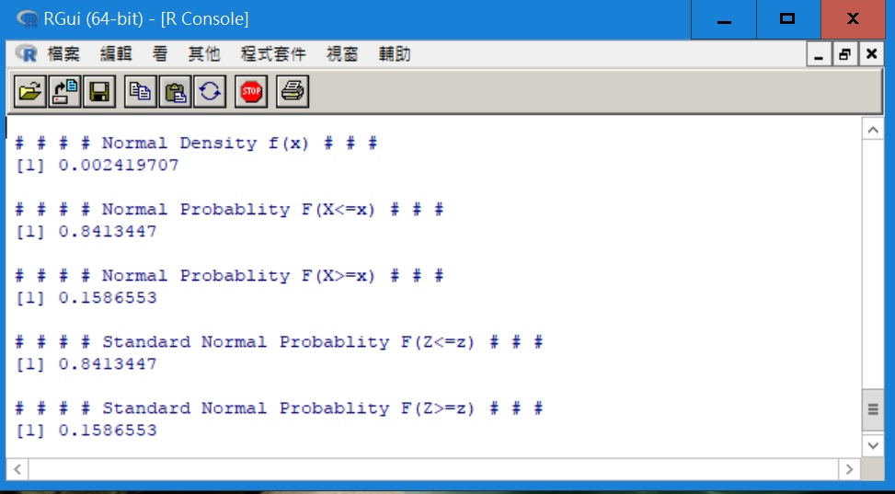
R Code
m <- 1000
s <- 100
x <- 1100
z <- (x - m) / s
cat("# # # # Normal Density f(x) # # # ","\n")
print(dnorm(x, mean = m, sd = s))
cat("# # # # Normal Probablity F(X<=x) # # # ","\n")
print(pnorm(x, mean = m, sd = s, lower.tail = TRUE))
cat("# # # # Normal Probablity F(X>=x) # # # ","\n")
print(pnorm(x, mean = m, sd = s, lower.tail = FALSE))
cat("# # # # Standard Normal Probablity F(Z<=z) # # # ","\n")
print(pnorm(z, mean = 0, sd = 1, lower.tail = TRUE))
cat("# # # # Standard Normal Probablity F(Z>=z) # # # ","\n")
print(pnorm(z, mean = 0, sd = 1, lower.tail = FALSE))

Slide 76
Example
Consider an investment whose return is normally distributed with a mean of 10% and a standard deviation of 5%.
Determine the probability of losing money.
Find the probability of losing money if σ is equal to 10%.

Slide 77
Definition
Let X denotes the return of an investment.
X ~ N(10%, 5%)

Slide 78
Solution 1/2
The investment loses money when the return is negative. Thus we wish to determine P(X < 0).
The first step is to standardize both X and 0 in the probability statement:
From Table 3, P(Z < − 2.00) = .0228
The probability of losing money is .0228

Slide 79
Solution 2/2
If we increase the standard deviation to 10%, that is, X ~ N(10%, 10%), the probability of suffering a loss becomes
From Table 3, P(Z < − 1.00) = .1587.
The probability of losing money is .1587

Slide 80
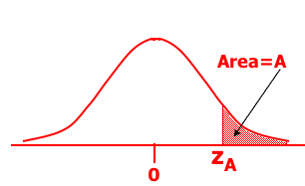
Finding Values of Z 1/2
Often we’re asked to find some value of Z for a given probability, i.e. given an area (A) under the curve, what is the corresponding value of z (z_{A}) on the horizontal axis that gives us this area? That is: P(Z > z_{A}) = A

Slide 81
Finding Values of Z 2/2
What value of z corresponds to an area under the curve of 2.5%? Or, what is z_{.025} ?
Area = .025
(1 – A) = (1 – 0.025) = .9750
If you do a “reverse look-up” on Table 3 for .9750,
you will get the corresponding z_{A} = 1.96.
Since P(z > 1.96) = .025, we say: z_{.025} = 1.96

Slide 82
Determine X for z_{A}
z_{A} is defined as the Z value for which the area to the right of z_{A} under the standard normal curve is A.
0.975
0.025
0.025
-1.96
-Z_{0.025}
0
Z_{0.025}
1.96

Slide 83
Example
The rate of return on an investment is normally distributed with mean of 30% and standard deviation of 10%. What is the probability that the return will exceed 55%?

Slide 84
Definition
Let X denotes the rate of return on an investment .
X ~ N(30%, 10%)
The question is to find P(X > 55%).
=> Convert X to Z

Slide 85

Solution
Convert X to Z:
=1–P(Z<2.5) = 1–.9938 = .0062
μ = 30%
X = 55%
0
Z=2.5

Slide 86
Question?
What is the probability that the return will be less than 22%?
22%
30%
-.8
= .2119

Slide 87
Question?
Determine the value X for which P(X < x) = .6331.
=> x =.34*10+30
= 33.4
0.6331
z
z = .34
0

Slide 88
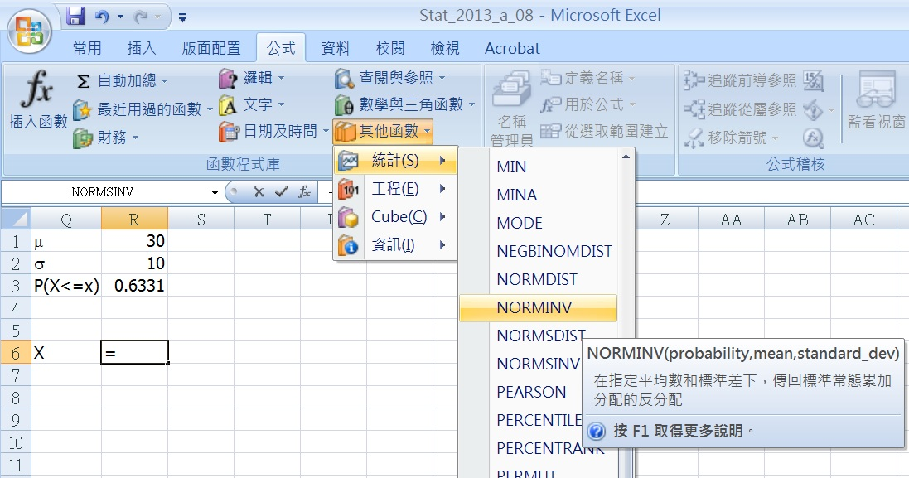
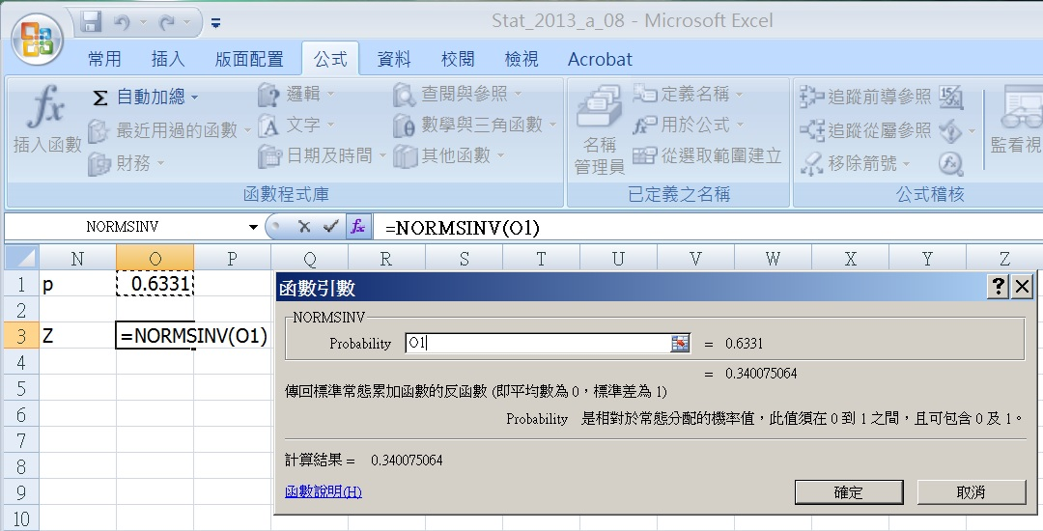
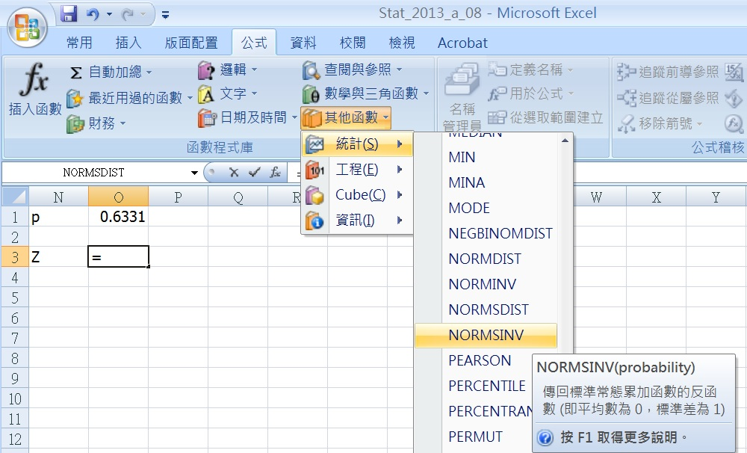
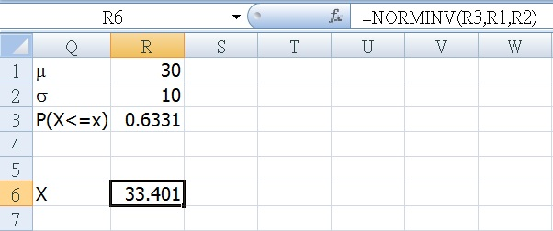
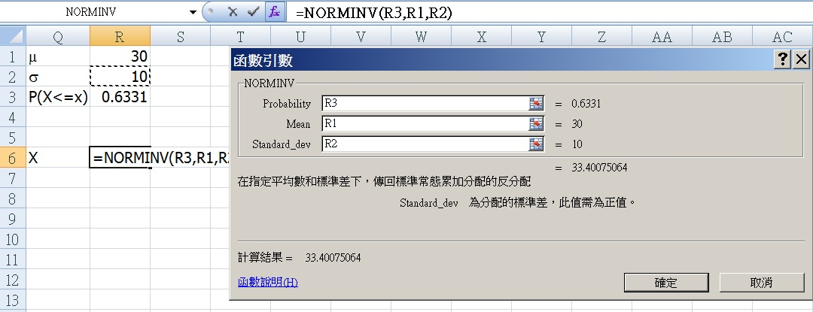
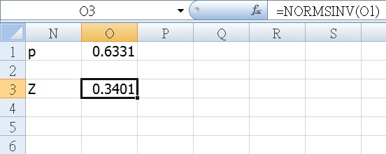
Excel Setup

Slide 89
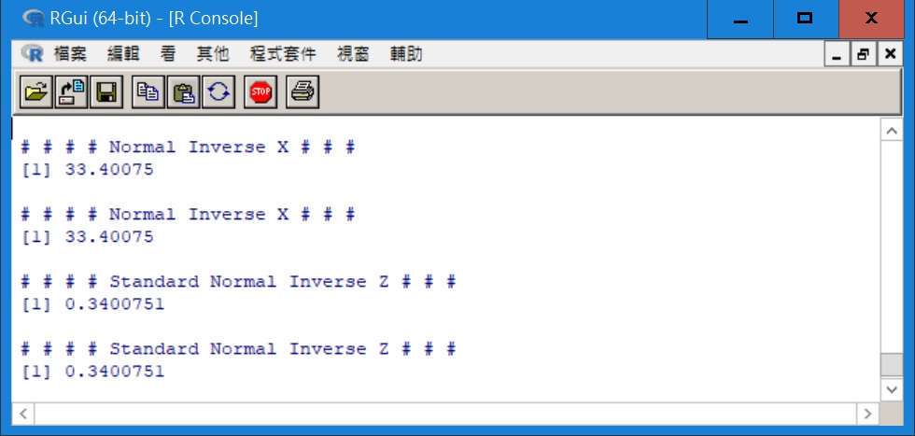
R Code
m <- 30
s <- 10
p <- 0.6331
q <- 1 - p
cat("# # # # Normal Inverse X # # # ","\n")
print(qnorm(p, mean = m, sd = s, lower.tail = TRUE))
cat("# # # # Normal Inverse X # # # ","\n")
print(qnorm(q, mean = m, sd = s, lower.tail = FALSE))
cat("# # # # Standard Normal Inverse Z # # # ","\n")
print(qnorm(p, mean = 0, sd = 1, lower.tail = TRUE))
cat("# # # # Standard Normal Inverse Z # # # ","\n")
print(qnorm(q, mean = 0, sd = 1, lower.tail = FALSE))

Slide 90
Agenda
Probability Density Functions
Normal Distribution
Exponential Distribution

Slide 91
Exponential Distribution 1/2
A random variable is exponentially distributed if its probability density function is given by f(x) = λe^{-λx}, x ≥ 0
where λ is a parameter (mean arrival rate or mean occurrence rate) of the distribution (λ>0)

Slide 92
Exponential Distribution 2/2
When the number of occurrences of an event follows the Poisson distribution, the time between occurrences follows the exponential distribution.

Slide 93
Apply Exponential Distribution
The length of time between telephone calls
The length of time between arrivals at a service station
The life-time of electronic components.

Slide 94
Expected Value and Variance of Exp(λ)
A random variable is exponentially distributed with
E(X) = 1/λ
Var(X) = 1/(λ²)
P(X ≥ a) = e^{-λa}
=> P(X ≤ a) = 1 – e^{-λa}

Slide 95
Shapes
f(x) = λe^{-λx}
f(x) = 2e^{-2x}
f(x) = 1e^{-1x}
For λ = 0.5, 1 and 2
f(x) =.5e^{-.5x}
0 1 2 3 4 5
P(a<x<b)
= e^{-λa} - e^{-λb}
a
b

Slide 96
Example
Cars arrive randomly and independently to a tollbooth at an average of 360 cars per hour.
Use the exponential distribution to find the probability that the next car will not arrive within half a minute.

Slide 97
Definition
Let X be the time (in minutes) that elapses before the next car arrives.
X is exponentially distributed with λ = 360/60 = 6 car per minute.

Slide 98
Question?
The probability that the next car will not arrive within half a minute?
=> P(X > 0.5)
P(X > 0.5) = e^{-6(.5)} = .0498

Slide 99
Question?
What is the probability that no car will arrive within the next half minute?
Y is a Poisson variable with μ = (.5)(6) = 3 cars per half a minute.
P(Y = 0) = e⁻³(3⁰)/0! = .0498
Same as the previous question.

Slide 100
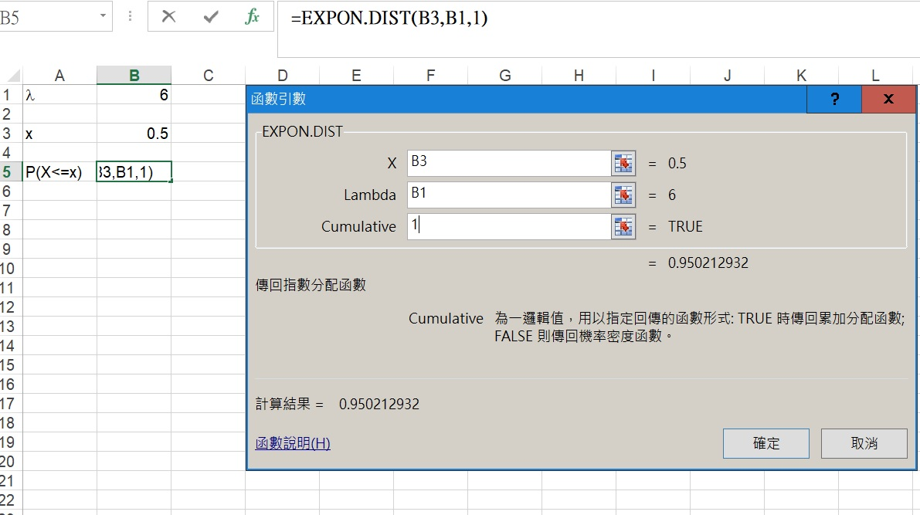
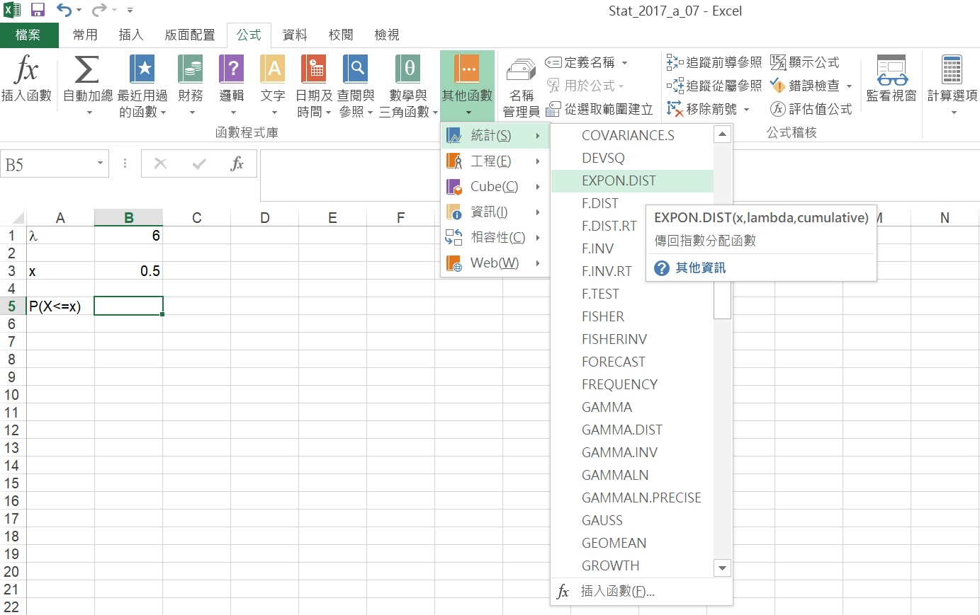
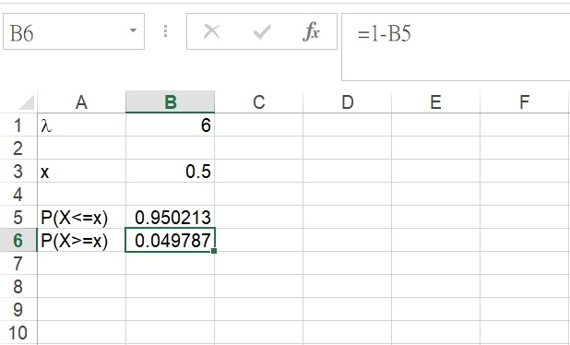
Excel Setup

Slide 101
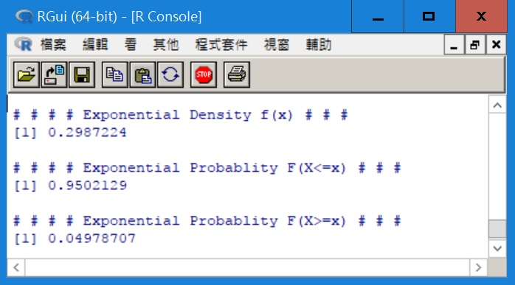
R Code
l <- 6
x <- 0.5
cat("# # # # Exponential Density f(x) # # # ","\n")
print(dexp(x, rate = l))
cat(" ","\n")
cat("# # # # Exponential Probablity F(X<=x) # # # ","\n")
print(pexp(x, rate = l, lower.tail = TRUE))
cat(" ","\n")
cat("# # # # Exponential Probablity F(X>=x) # # # ","\n")
print(pexp(x, rate = l, lower.tail = FALSE))

Slide 102
Example
The lifetime of a transistor is exponentially distributed, with a mean of 1,000 hours.
What is the probability that the transistor will last between 1,000 and 1,500 hours?

Slide 103
Define
Let X denote the lifetime of a transistor (in hours).
E(X) =1000 = 1/λ
So λ = 1/1000 = .001
P(1000 < X < 1500)
= e^{-(.001)(1000)} - e^{-(.001)(1500)}
= .1448

Slide 104
End of Chapter 8

Slide 105
Homework
Do not turn in the homework next week
8.9, 8.13,
8.45, 8.53, 8.63,
8.75, 8.79

Slide 106
Geometric Experiment
The success occurs at X+1 (first successful) trial or the last trial.
Each trial is an Independent Bernoulli Trial.
The success probability p is the same at each trial.
Each trial has only two outcomes (success or failure).

Slide 107
Probability P(X ≥ α)

Slide 108
Expected Value of Exponential Distribution

Slide 109
Integrals Involving e^{ax}

Slide 110
Variance of Exponential Probability Distribution

Slide 111
Expected Value of Uniform Probability Distribution

Slide 112
Variance of Uniform Probability Distribution

Slide 113
Standard Normal Distribution
A random variable, Z, with mean = 0 and variance = 1 is normally distributed if its probability density function is given by

Slide 114
The Shape of the Binomial Distributions
In general, for any number of trials n:
1. Symmetric if p = 0.5
2. Skew to the right if p < 0.5
3. Skewed to the left if p > 0.5

Slide 115
Using Table 3 1/5
Suppose we want to determine the following probability: P(Z < −1.52)
We first find −1.5 in the left margin. We then move along this row until we find the probability under the .02 heading.
Thus, P(Z < −1.52) = .0643

Slide 116
Using Table 3 2/5
We want to find the probability that Z is greater than 1.80, P(Z > 1.80),
by determining the probability that Z is less than 1.80, P(Z < 1.80),
and subtracting that value from 1.
Applying the complement rule we get P(Z > 1.80) = 1 – P(Z < 1.80) = 1 − .9641 = .0359

Slide 117
Using Table 3 3/5
Find the probability P(−1.30 < Z < 2.10)?
Find the 2 cumulative probabilities and calculating their difference.
P(Z < −1.30) = .0968 and P(Z < 2.10) = .9821
Hence, P(−1.30 < Z < 2.10)= P(Z < 2.10) − P(Z < −1.30) = .9821 −.0968 = .8853

Slide 118
Using Table 3 4/5
Notice that the largest value of z in the table is 3.09, and that P( Z < 3.09) = .9990. This means that P(Z > 3.09) = 1 − .9990 = .0010
However, because the table lists no values beyond 3.09, we approximate any area beyond 3.10 as 0. That is, P(Z > 3.10) = P(Z < −3.10) ≈ 0

Slide 119
Using Table 3 5/5
Recall that in Tables 1 and 2 we were able to use the table to find the probability that X is equal to some value of x, but that we won’t do the same with the normal table.
Remember that the normal random variable is continuous and the probability that a continuous random variable it is equal to any single value is 0.

Slide 120
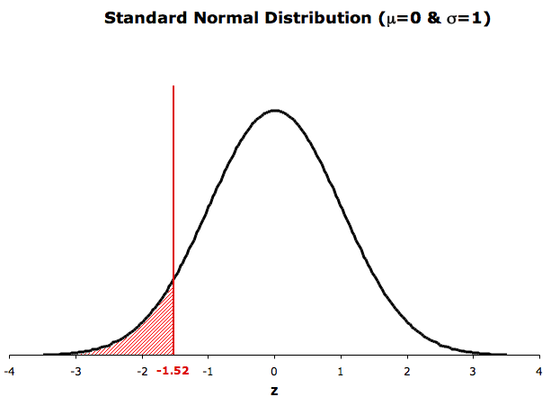
Normal Probability Table
Normal Table
The tabulated probabilities correspond to the area between Z =-∞ and Z = z₀
Z=-∞
Z=-1.52
P(-∞<Z<-1.52)
z | 0.00 | 0.01 | 0.02 | … | 0.09
-3.0 | 0.0013 | 0.0013 | 0.0013 | … | 0.0010
… | … | … | … | … | …
-1.5 | 0.0668 | 0.0655 | 0.0643 | … | 0.0559
… | … | … | … | … | …
3.0 | 0.9987 | 0.9987 | 0.9987 | … | 0.9990
= 0.0643

Slide 121
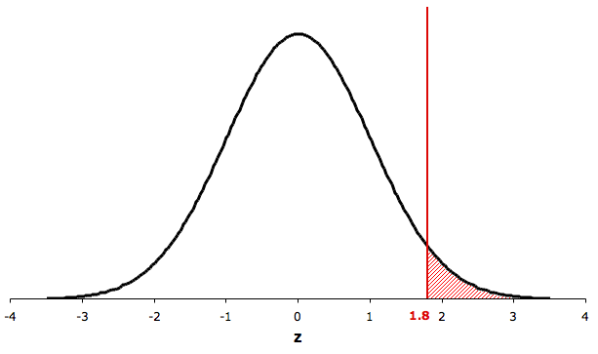
Greater Than
P(Z > 1.80) = 1 – P(Z < 1.80)
= 1 − .9641 = .0359

Slide 122
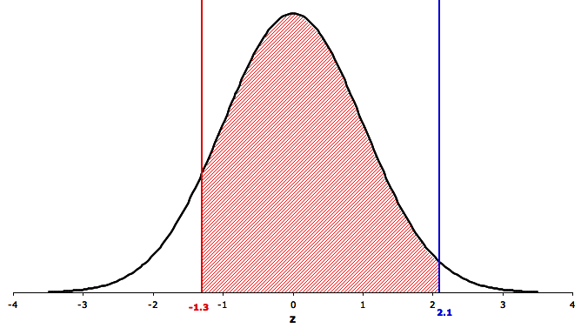
In Between
P(−1.30 < Z < 2.10)
= .9821 −.0968 = .8853

